Slide 1

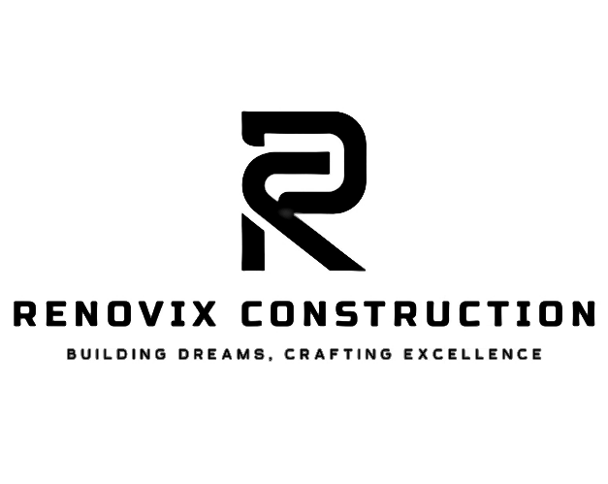



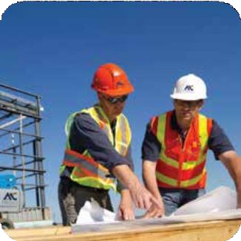
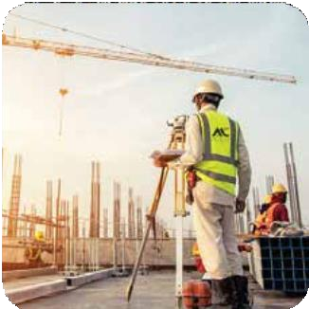
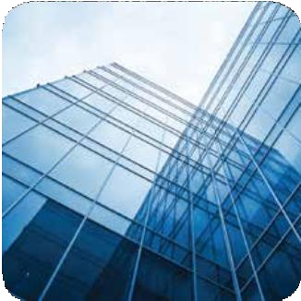
شركة رينوفيكس للمقاولات Renovix Construction Company
Design
Construction
Maintenance

Slide 2
INDEX
About us GM Message
Vision & Mission, Our Core Values Our Policies
Our Team & Experience What We Do
Why Us
Corporate Information
Organization Chart Projects
Clientele
Contact Us

Slide 3
ABOUT US
Founded in 2019 in Riyadh by experienced industry professionals, Renovix Contracting Company delivers integrated solutions tailored for the construction and related sectors. Our main goal is to reduce risk and improve compliance, with our accreditations ensuring clients of our dependability. We provide a wide array of services, encompassing Design, Construction, Operations, and Maintenance, all aimed at maximizing cost efficiency.
Our comprehensive turnkey solutions cover all aspects, from initial feasibility assessments and cost analysis to design oversight, construction, and subsequent maintenance.
Acknowledged as one of Saudi Arabia's leading experts in turnkey interior fit-outs and electro-mechanical (MEP) services, we believe that luxury is defined by personalization and experience. Our services are customized to align with each client's specific requirements, and we aim to build lasting partnerships through outstanding quality and a profound understanding of practical applications, resulting in a diverse clientele.
Our projects are managed by skilled engineers and carried out by a highly competent workforce. Our unique advantages stem from innovative design and effective execution. With over fifteen years in the field, our team consists of engineers with technical know-how, in addition to designers and project managers who have substantial experience in overseeing and executing turnkey projects.
We operate across various sectors, including residential, commercial, corporate, institutional, healthcare, and industrial projects, catering to some of the most prestigious global brands.
Our commitment is focused on
QUALITY ASSURANCE DEADLINE INNOVATION
COST-EFFECTIVE AFFORDABILITY
RENOVIX CONSTRUCTION COMPANY

Slide 4

GM MESSAGE
On behalf of our engineers and team members, I am delighted to announce that since the establishment of RENOVIX CONTRACTING COMPANY, we have consistently delivered outstanding results aligned with our growth objectives. We have reached significant milestones through the successful completion of major projects throughout the Kingdom. Our emphasis on growth strategies and our capacity to secure new and critical ventures in the Kingdom highlight our strengths in planning and achieving greater synergy. Our long-term vision, strategic approach, execution capabilities, and commitment position us as a key player in Design, Construction, MEP, Interior Fit-Out, and Operations & Maintenance, all of which have been reinforced by our endeavors.
I would like to express my heartfelt appreciation to our management and staff for their extraordinary dedication and commitment to consistently achieving and surpassing our goals. We must also acknowledge the steadfast support of our business partners and loyal clients.
Looking ahead, we foresee an exciting journey with expansion plans across various sectors, a robust order book, and a proactive approach focused on identifying long-term growth opportunities.
I am confident that with the ongoing support of everyone involved, we will accomplish this and even more.
Engr Akram Uddin Syed
MANAGING DIRECTOR
“Editing is an important part of the process; finning out the exceptional details is what makes the difference between a project and a landmark”
Thanking You…

Slide 5
OUR POLICIES
OUR TEAM & EXPERIENCE
RENOVIX CONTRACTING COMPANY has consistently distinguished itself through superior quality, enhancing its reputation for excellence with a strong dedication to meticulous quality control and evaluation. Our comprehensive quality management system aligns with the standards set forth by clients and consultants, as well as additional national and international benchmarks. This system serves as a foundational element for delivering unique solutions across all operations. Key components of the system ensure process monitoring and improvement based on measurable goals, alongside the ongoing enhancement of customer satisfaction. Our production facilities and laboratories ensure manufacturing consistency by rigorously testing construction-related materials and strictly adhering to established company standards.
Moreover, our unwavering commitment to quality is supported by investments in the professional growth of our staff across all departments.
Project Management & Cost Control
At Renovix Construction Company, our specialists possess extensive experience in project management and oversight. They have participated in a wide array of large-scale ventures, including both commercial and residential developments, as well as specialized planning and development projects. Effective cost control is essential for successful construction, and our comprehensive management approach provides an overarching perspective throughout all phases of the construction process.
“Our team oversees every detail, from the initial idea and concept development to the final realization. We honor traditional practices while integrating them into our innovative solutions. Every project we undertake features a distinctive artistic vision and practical solutions. The client is at the heart of the project. Our primary objective is to reflect their values and individuality.”
Our Commitment to Exceeding Clients' Expectations
This commitment starts with our experienced team dedicated to fulfilling your construction and facility requirements, and this is merely the beginning. On-site and behind the scenes, you will experience a collaboration of skilled craftsmen, seasoned technicians, diligent workers, devoted supervisors, and detail-oriented project engineers who manage every element of the project.
Our management team is devoted to excellence, enabling you to build, expand, and progress with confidence every time you partner with us. RENOVIX CONTRACTING COMPANY takes pride in the fact that most of our team members have been with us for many years. We prioritize the well-being of our staff, allowing them to fully focus on meeting the needs of our clients.

Slide 6
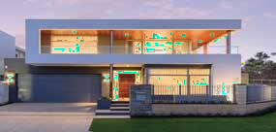
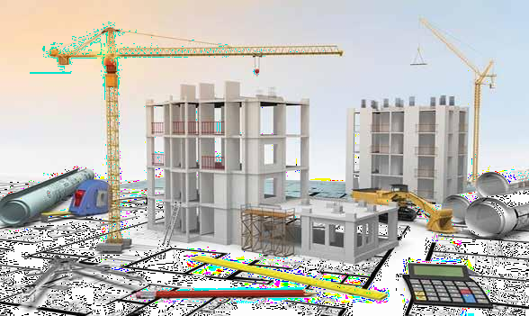
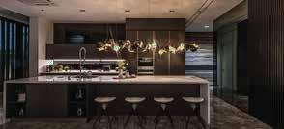
ELEGANCE
CONSTRUCTION
Engineering services relating to building construction have formed a core activity in our operations since the company was founded, we offer our clients direct access to a team of highly qualified and experienced specialists offering consultancy services in preliminary work, building construction, as well as construction supervision, RENOVIX CONTRACTING COMPANY has served on almost every type of building project including, Residential, Commercial Sectors, Institutional, Hospitality, Corporates, Industrials & Health Care.
From preliminary or structural execution for remodeling buildings and other structures, to the execution of Interior, HVAC, Electrical (LV and MV), Mechanical, Infrastructure and control systems, to developing fire & life safety plans and constructing diverse acoustical solutions, specialists at RENOVIX CONTRACTING COMPANY have the knowledge & experience to solve all kinds of complex project challenges.
‘’We display elegance at its best, by using the correct lighting, the perfect material like wood, glass and raw material, which can unveil beauties never explored ever before’’

Slide 7


WHY US ?
Our Reputation Has Been Established Over the Years
While builders may come and go, you can rely on RENOVIX CONTRACTING COMPANY to support you throughout the entire building process and beyond. Whether you are considering a house remodel or building a new home, it’s essential to engage a contractor who is dependable, trustworthy, and committed to completing your project successfully.
Exceptional Service
From the initial concept to the final construction, you can expect personal attention dedicated to your project. We encourage our clients to ask questions and maintain open communication. Keeping you informed throughout the process ensures a smooth transition between phases and, most importantly, leads to a successful project and a satisfied homeowner.
Quality Focused
With an emphasis on quality and design tailored to the customer, we take pride in utilizing the finest materials, advanced building techniques, and skilled professionals. This approach guarantees that homeowners receive the best possible return on their investment.
Competitive & Fair Pricing
We believe that quality should not be compromised for affordability. Our goal is to provide high-quality workmanship at a reasonable price. Over the years, we have developed strong relationships with loyal suppliers and subcontractors, allowing us to benefit from volume discounts that are reflected in our competitive pricing.
"WARRANTY" We Stand Behind It
At RENOVIX CONTRACTING COMPANY, we take great pride in the quality of our work and stand firmly behind our finished projects. Should any issues arise, we are readily available to address them. All our work comes with a one-year warranty, and many products used in your project may even carry longer warranty periods.
MAINTENANCE
of buildings enhances the lifespan of the structure, hiring an experienced professional is a wise decision, it improves the overall health of the building,Our Building maintenance team install and Operates Building Management System (BMS), which monitors and controls the electrical and mechanical equipment, it takes in control of fire system, security system, HVAC - ventilation, power system and lighting, we have a range of integrated programs that include, predictive and corrective maintenance, along with life cycle asset management and indoor air quality and environmental health and safety, we give our clients reliable and trustworthy services, the professionals maintain a sweet relationship with the clients, our company charges an affordable price in the maintenance and installation service

Slide 8
Organization Chart :
Engr Akram Uddin ( General Manager)
Engr Mohammed Shahbaz ( Operational Manager)
Technical Team
Engr Syed Mujeeb
( Mechanical Section Head)
Engr Mohammed Jawwad( Electrical) Section Head)
Project Execution Team
Engr Syed Atif Ahmed
( Project Engineer – Mechanical)
Engr Taqi Ullah (Mechanical Engineer)
Elect Engr Abdul Aziz ( Project Engineer )
Engr Mirza Omar (Site Engineer – Electrical)
Abid Ali (Draftsmen)
Document Controller
QA/QC Engineer
Electrical QA/QC
Mechanical QA/QS
QS
Engr Salman ( Mechanical Engineer)
Design Team
Engr Ansar (Site Engineer – Electrical)
Field Teams
Field Teams
Field Teams
Field Teams
Safety Engineer

Slide 9
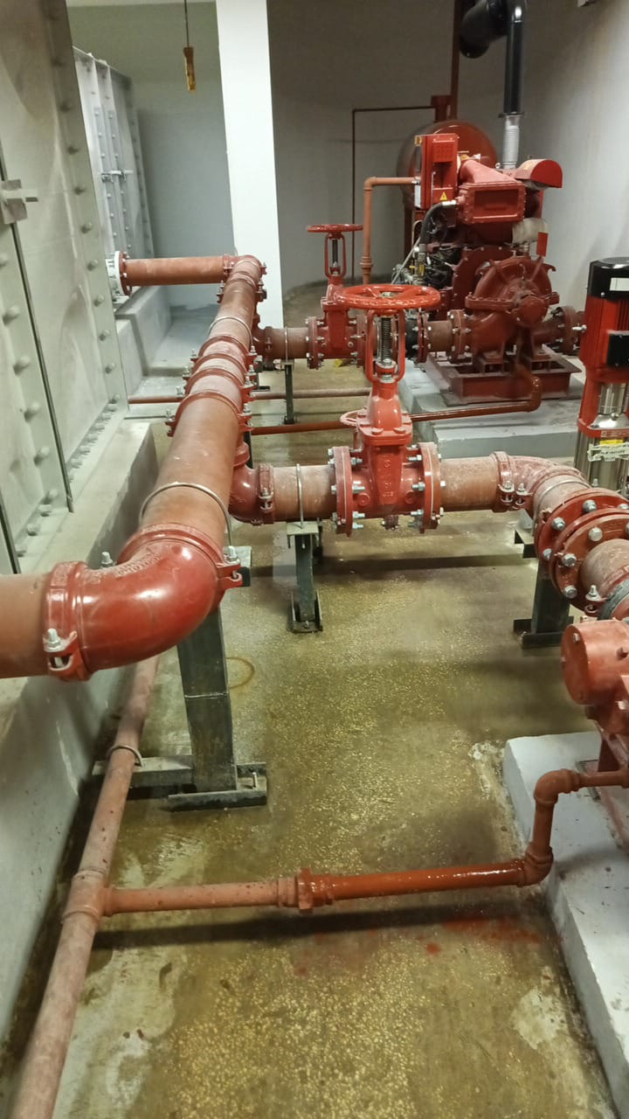
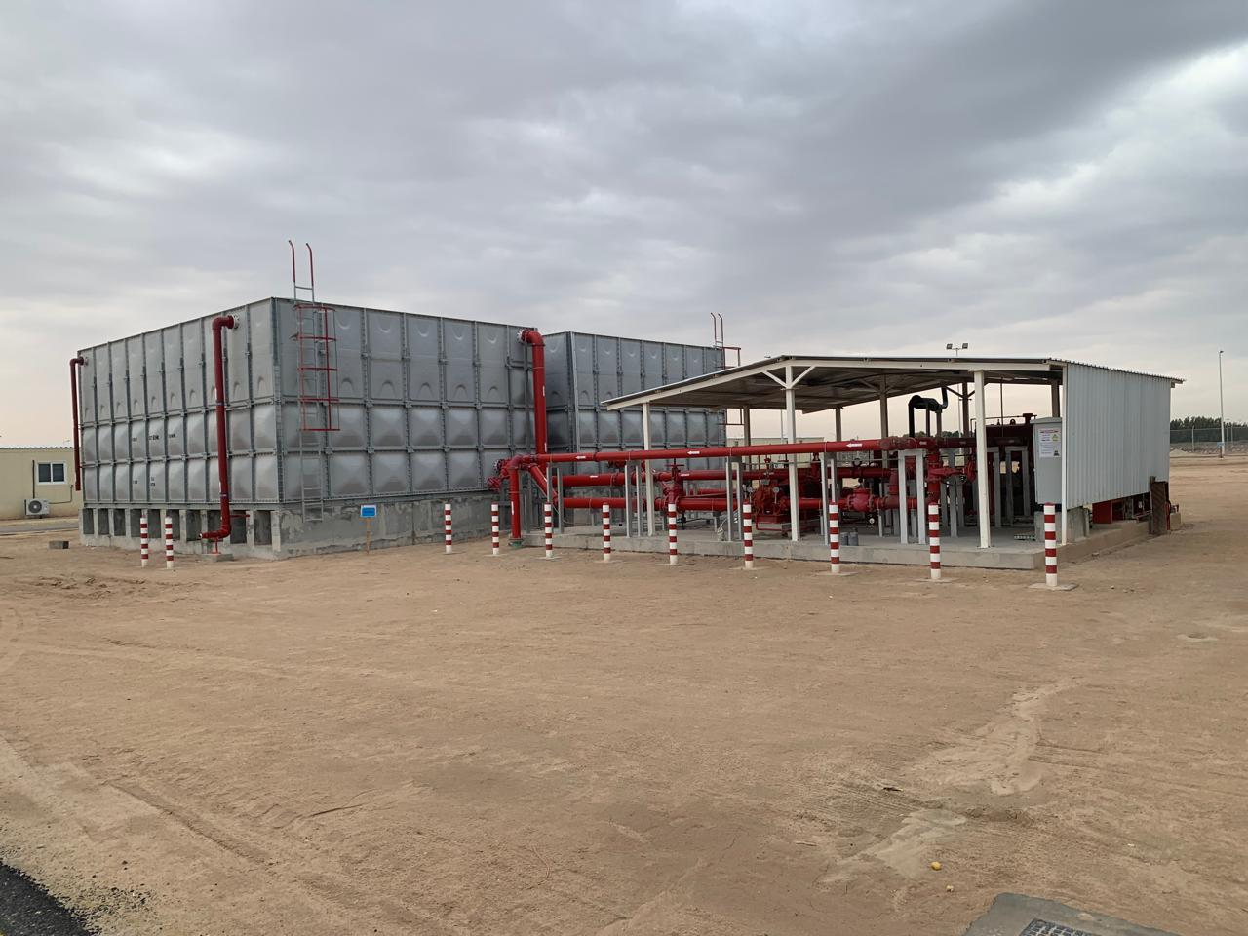
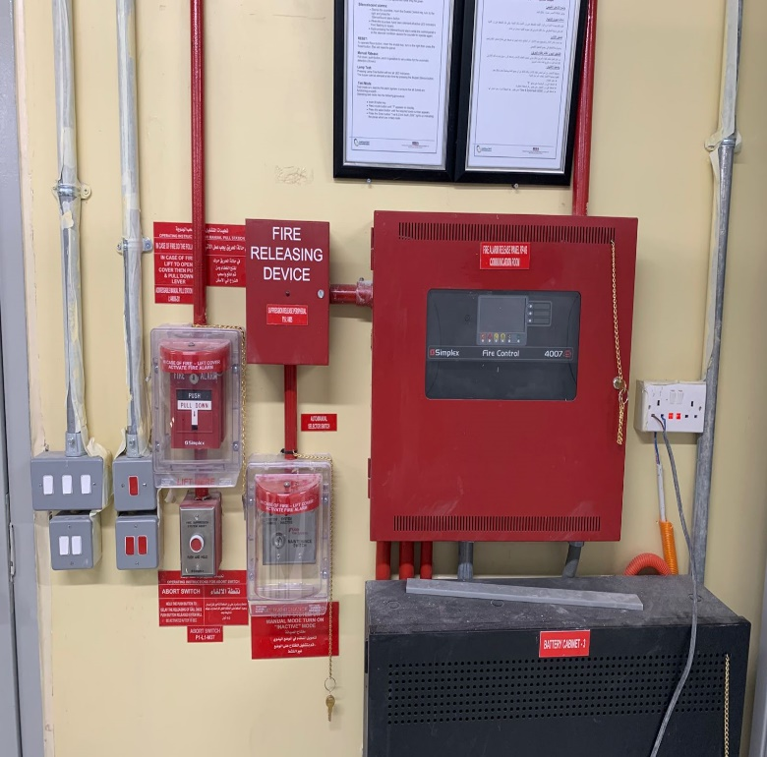
ON GOING PROJECTS
Client:
Main Contractor
Location Project Project Area
Project Duration
: Seah-DUSSUR
: SENDAN.
: BAQAIQ-Dammam
: STEEL ALLOY PLANT
12000 M2
: 8 Months
Scope of Work: Preparation of Shop Drawings with Clients Concern, Supply, Install, Testing & Commissioning of Firefighting, Fire Alarm, Underground Utility System ( Storm, Sewage, Portable, Irrigation and Industrial sewage) and NG Gas system for over all 12 buildings inside the Factory including infrastructure works.
Electrical Works: Fire Alarm Addressable system and Gas detection system for Natural gas.
Fire Fighting System & Plumbing: Fire Suppression system, Foam System, Fire Sprinkler system, FRP Tanks, Fire Pumps, Underground Utility System ( Storm, Sewage, Portable, Irrigation and Industrial sewage) and NG Gas system.

Slide 10
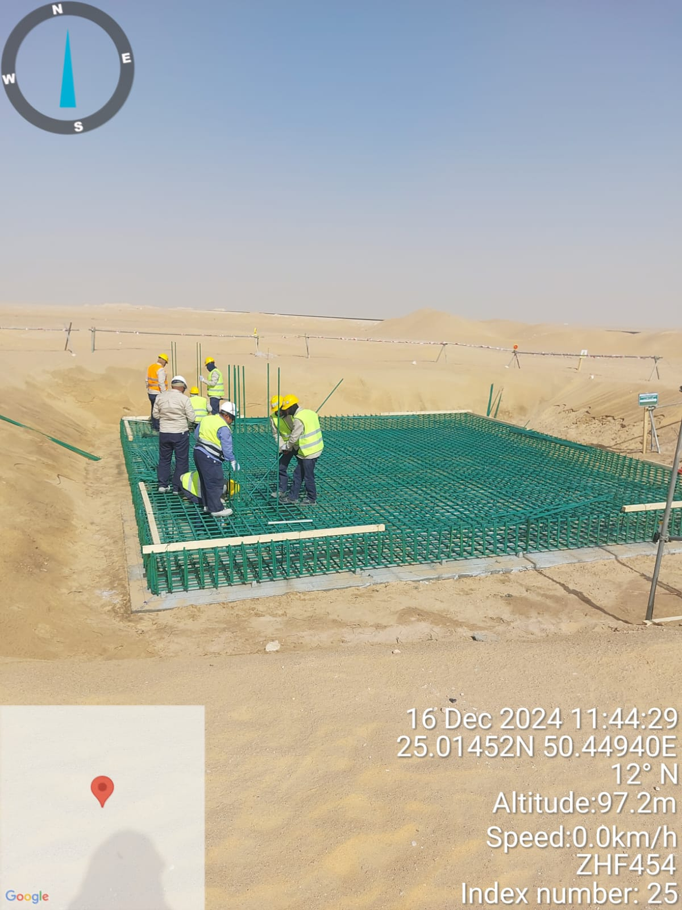
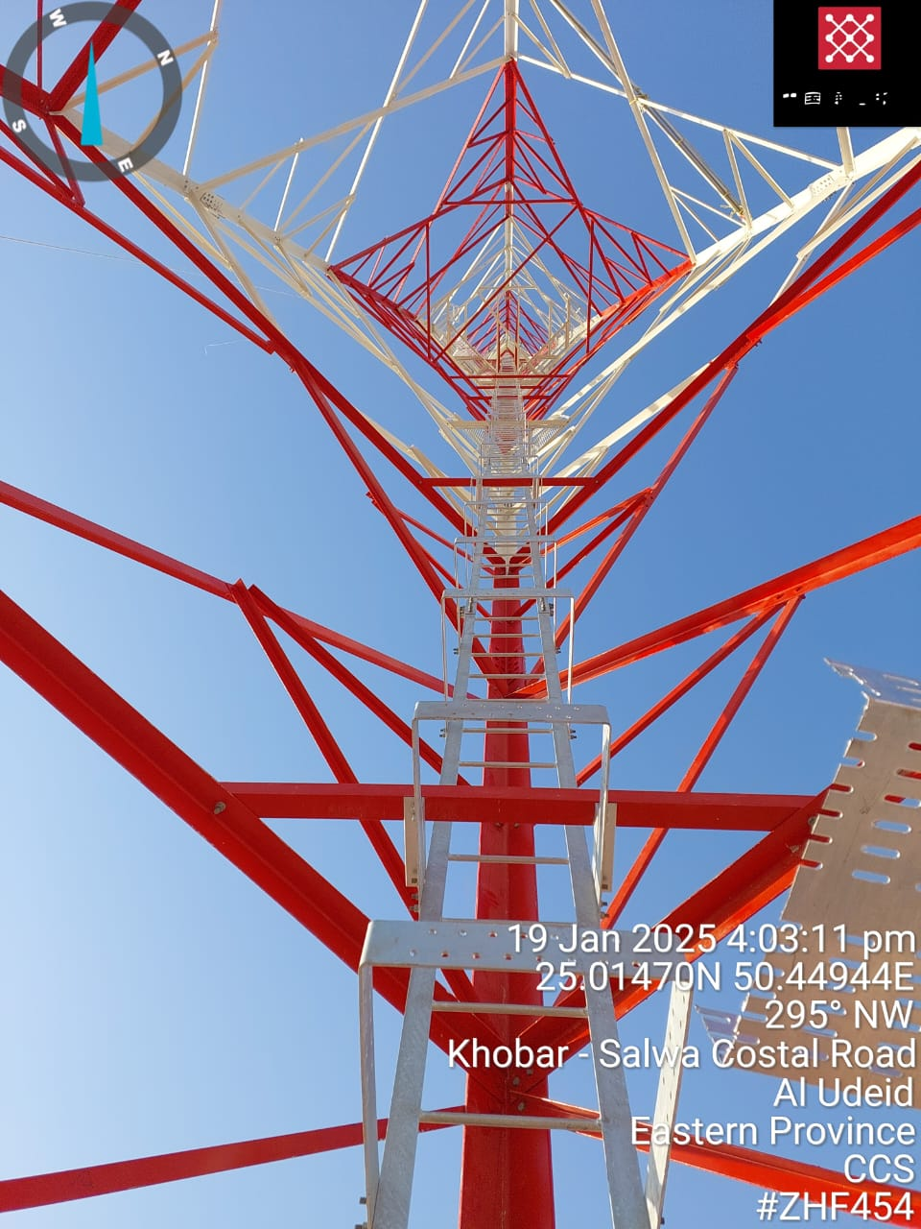
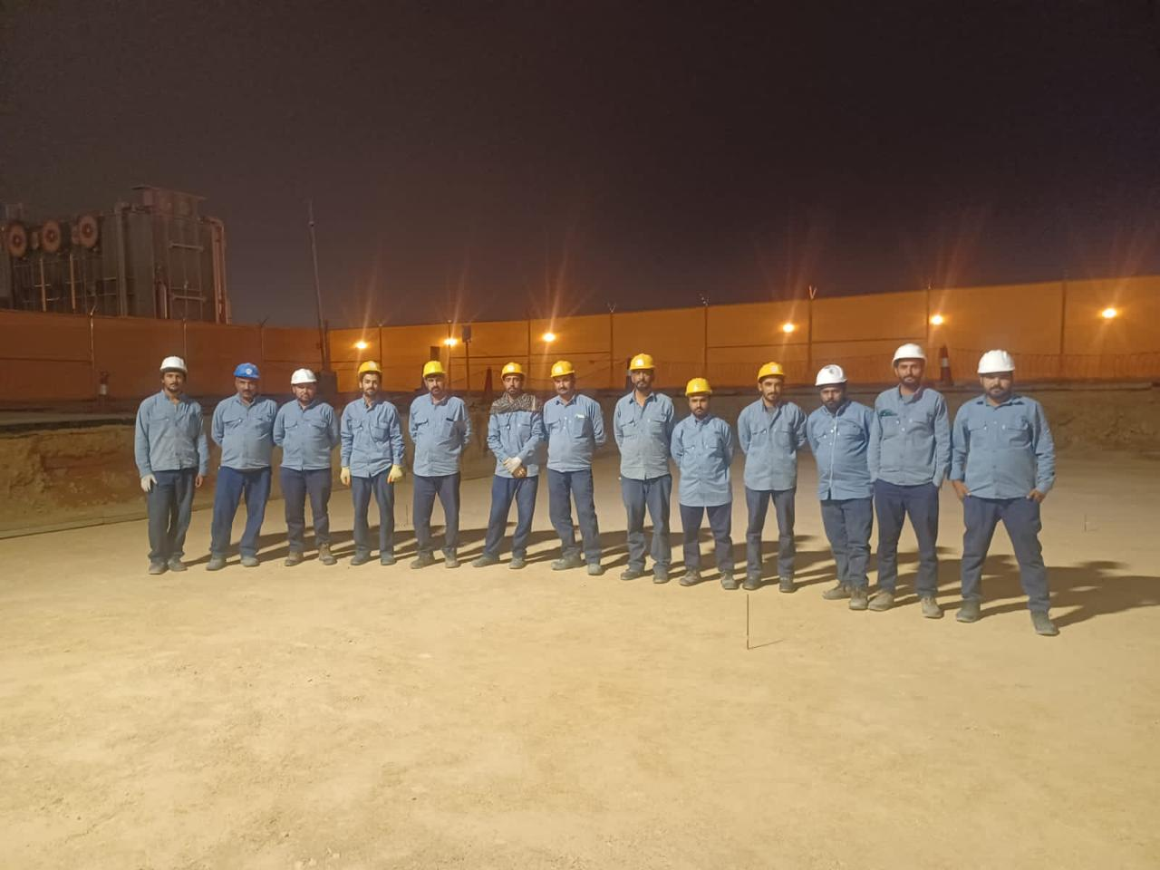
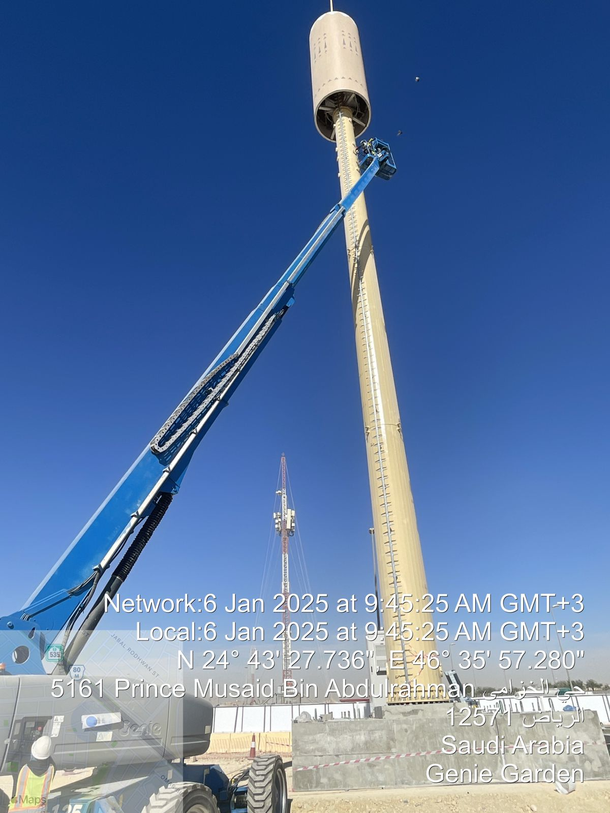
ON GOING PROJECTS
Client:
Main Contractor
Location Project
Tower Height
Project Duration
No. Of Towers
: TAWAL
: China Com Service.
: All over KSA
: TAWAL B2S PROEJCT
: 35 to 60M of Height
: 1 year
: 35 in Hand
Scope of Work:
To construct new Telecom Towers at Multiple Sites within the Kingdom of Saudi Arabia in compliance with the requirements of TAWAL /CCS and applicable regulations. This involves Site development, tower supply for RT Sites and rapid solutions (including but not limited to GRD, RDLP, RDM, etc.) and tower erection, tower foundation, access road (if required), fences, gates, shelters/ODUs, powers and hybrid, provision of temporary power, commercial power connection and energizing, electrical cables, distribution panels, grounding, batteries, rectifiers, security alarm and monitoring systems, asset tagging, warehousing and other related activities to make the Site ready for installation (RFI), acceptance and handover to CCS/TAWAL O&M in accordance with TAWAL/CCS standards and specifications, using TAWAL/ CCS approved materials and material suppliers, and fully adhering to TAWAL/CCS health and safety regulations and standards. The scope also involves uploading data and updating TAWAL /CCS systems.

Slide 11
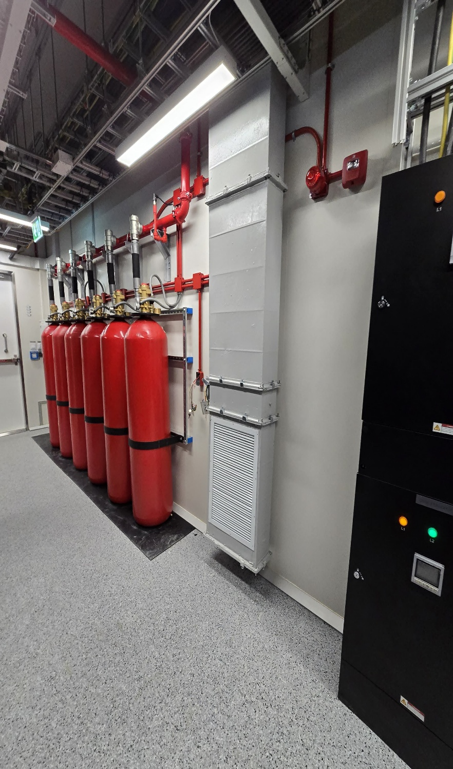
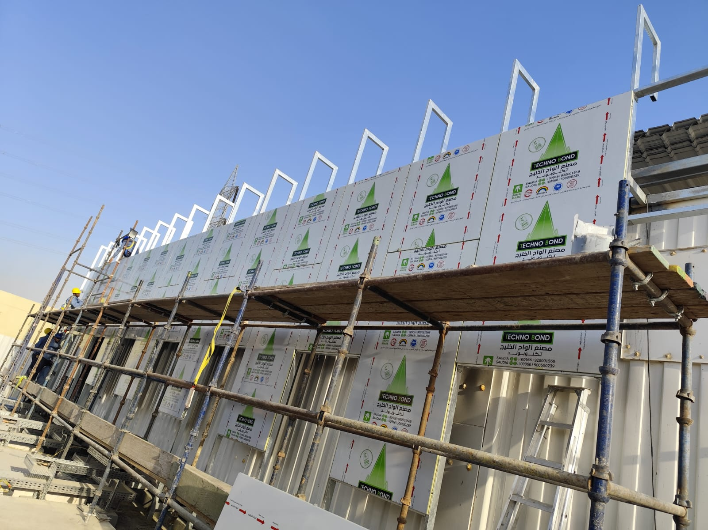
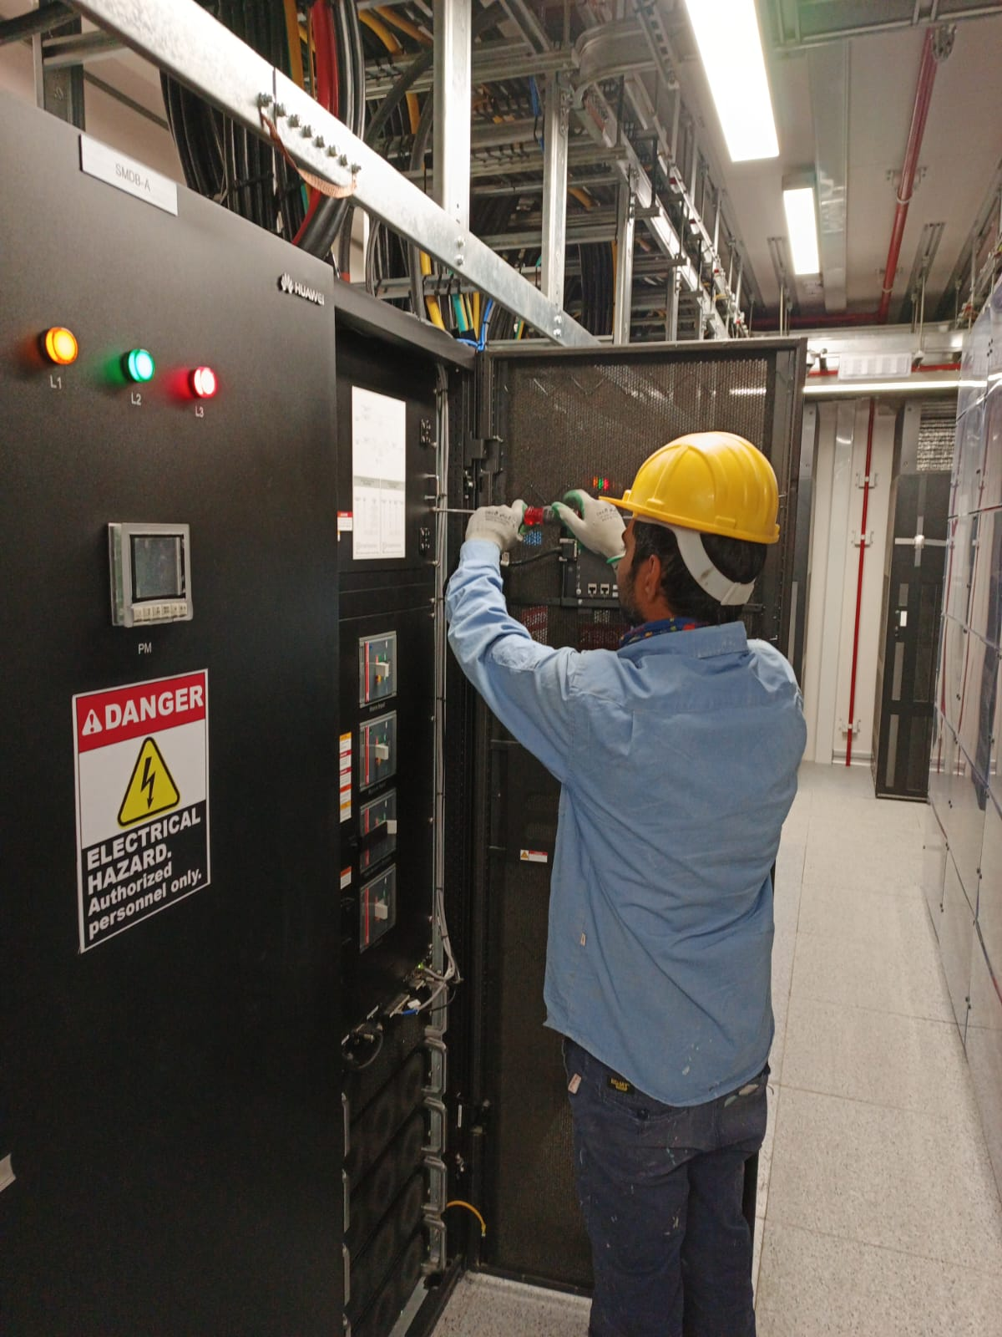
ON GOING PROJECTS
Client:
Main Contractor
Location Project
Project Type
Project Duration
: DAWIYAT
: China Com Service.
: RIYADH and Dammam
: Construction of Data Centers
: Data Center
: 1 year
Scope of Work:
A turnkey project includes of Preparation of Shop Drawings with Clients Concern, Supply, Install, Testing & Commissioning.
Civil & Architectural Works: MEP Trench, Metal Works, Porcelain & Vinyl Flooring, Gypsum Ceiling, Partitions & Acoustic Ceilings, Painting Works, Mechanical Stone, Frame works Metal cladding and Tile Fixing.
Electrical Works: Installation of Lightning System, Distribution Panels,, Cable Ladder, LV- Cables, LC Cables, External Lighting Fixtures, Internal Lighting Fixtures, Wiring Devices, Disconnect Switches, Fire Alarm System, MCC, Sub-distribution Panel Boards, Cable Trays Telephone & Data System, Public Address System, Access Control System, CCTV System.
Fire Fighting System & Plumbing: Fire Sprinkler system, Fire Pumps, Water Supply System, Drainage System, Strom water System, Sanitary Fixture installation, Diesel Tank Installation and Piping, LPG system HVAC System: Supply and Installation of HVAC system including PACU and Duct work.

Slide 12
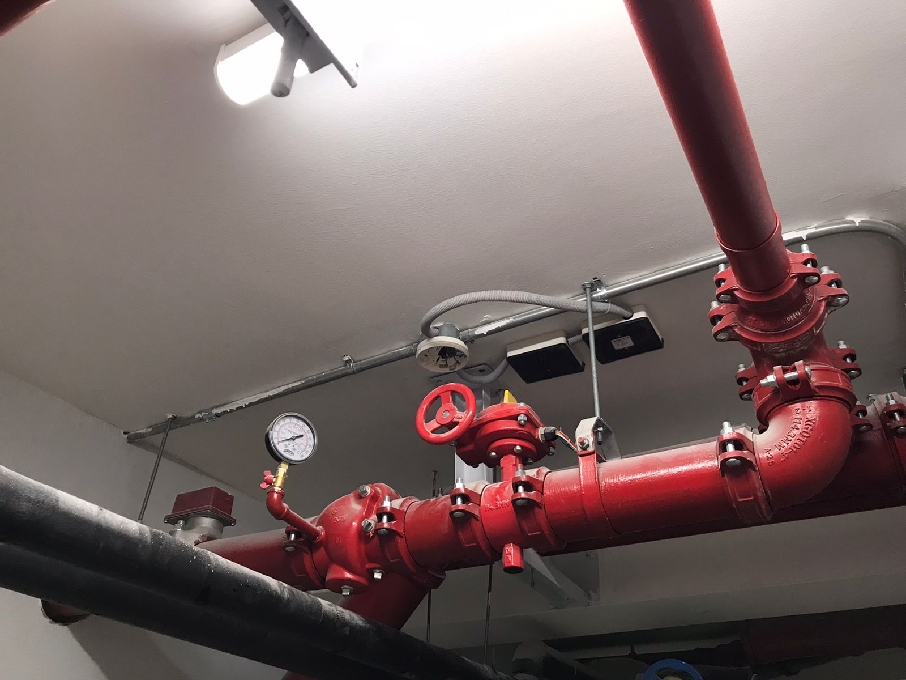
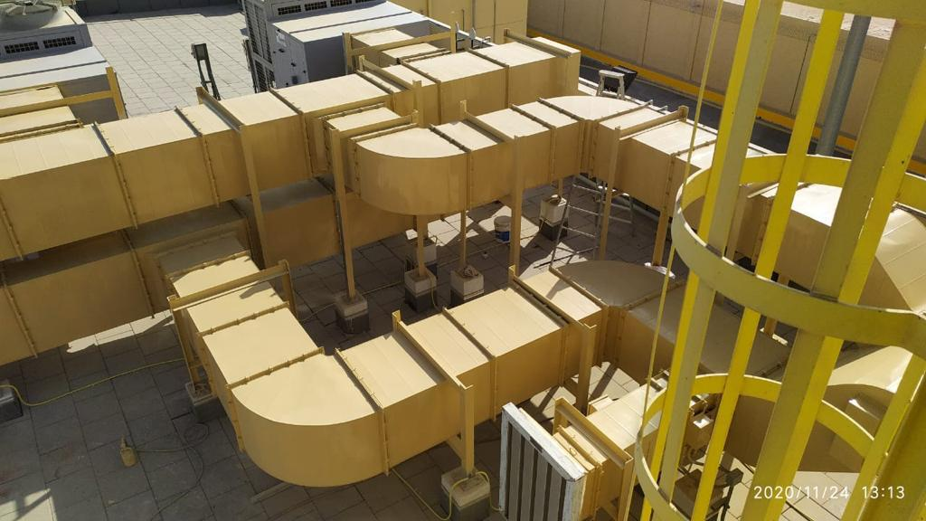
ON GOING PROJECTS
Client:
Main Contractor
Location Project
Project Type
Project Duration
: Al Mawarid
: Saudi Geo
: RIYADH
: MEP Works
: Commercial Building
: 6 Months
Scope of Work: Preparation of Shop Drawings with Clients Concern, Supply, Install, Testing & Commissioning.
Electrical Works: Installation of Lightning System, Distribution Panels, MCC, Sub-distribution Panel Boards, Cable Trays, Cable Ladder, LV- Cables, LC Cables, External Lighting Fixtures, Internal Lighting Fixtures, Wiring Devices, Disconnect Switches, Fire Alarm System, Telephone & Data System, Public Address System, Access Control System, CCTV System.
Electrical and Plumbing Systems: HVAC, Fire Sprinkler system, Fire Pumps, Water Supply System, Drainage System, Sanitary Fixture installation,
HVAC System: Supply and Installation of HVAC system including AHU, FCU, Duct work, Condenser Unit installation And its piping Work.

Slide 13
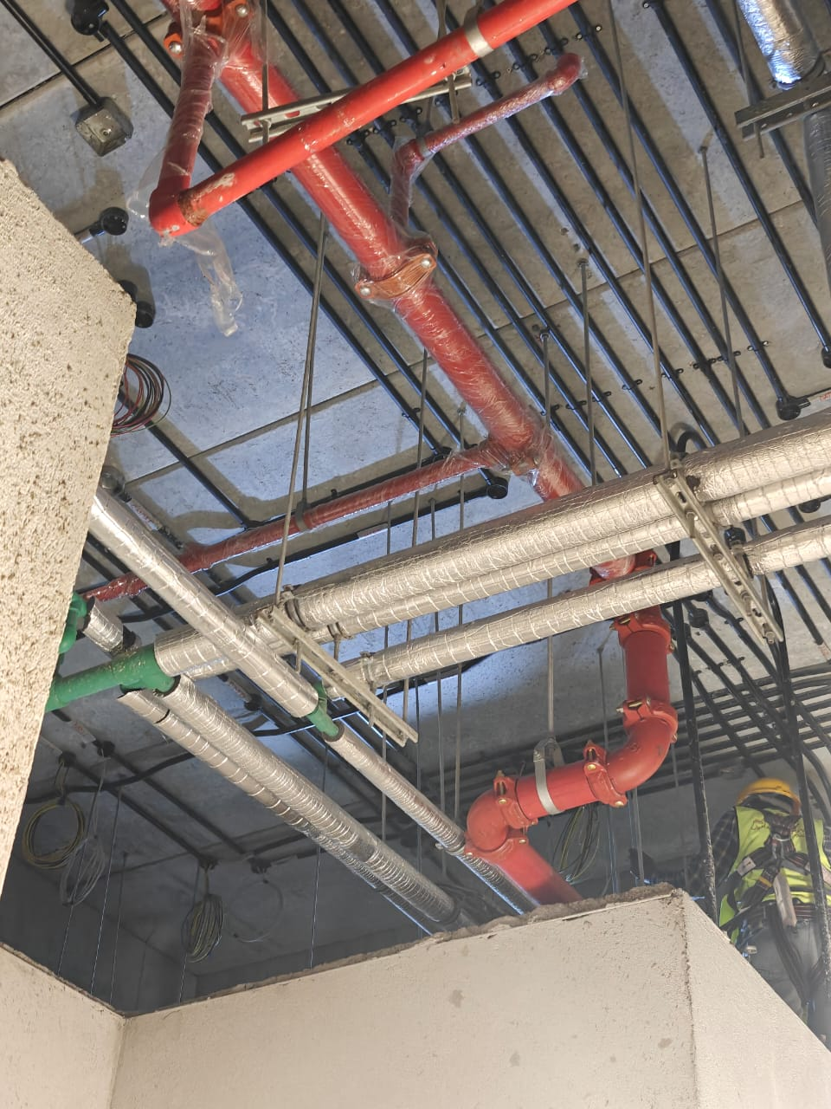
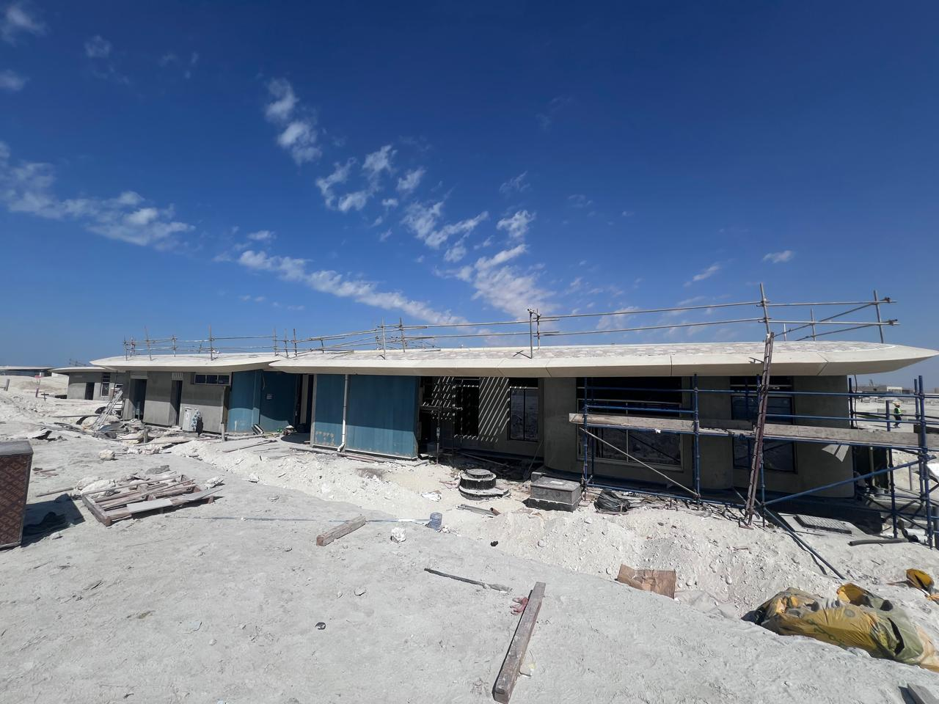
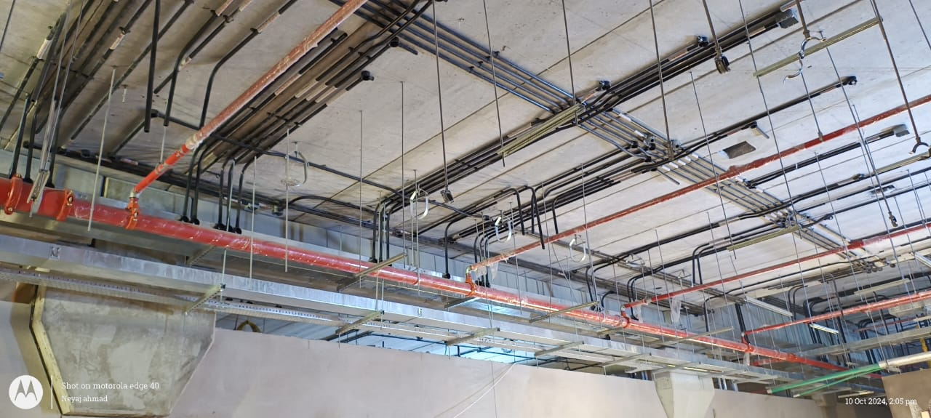
ON GOING PROJECTS
Client:
Main Contractor
Location Project
Project Type
Project Duration
: RED SEA
: First Gulf Contracting Co.(FGC)
: Umluj
: HE1 at Shoura Island
: Hotels and Resorts
: 1 year
Scope of Work:
Scope of Work: Supply, Install, Testing & Commissioning of MEP Services at RED Sea Port Project, Shoura Island.
Electrical Works: Installation of Lightning System, Distribution Panels, MCC, Sub-distribution Panel Boards, Cable Trays, Cable Ladder, LV- Cables, LC Cables, External Lighting Fixtures, Internal Lighting Fixtures, Wiring Devices, Disconnect Switches, Fire Alarm System, Telephone & Data System, Public Address System, Access Control System, CCTV System.
Mechanical Works: Fire Fighting System & Plumbing: HVAC System: Supply and Installation of HVAC system including PACU and Duct work.

Slide 14
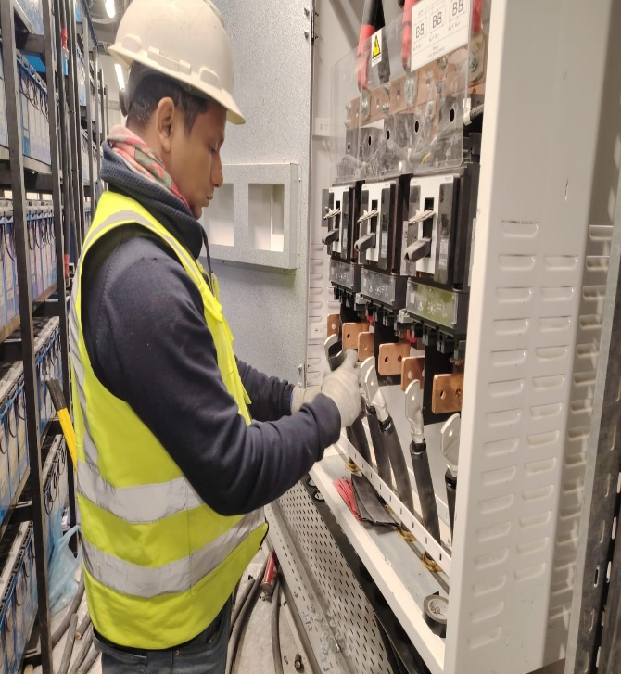
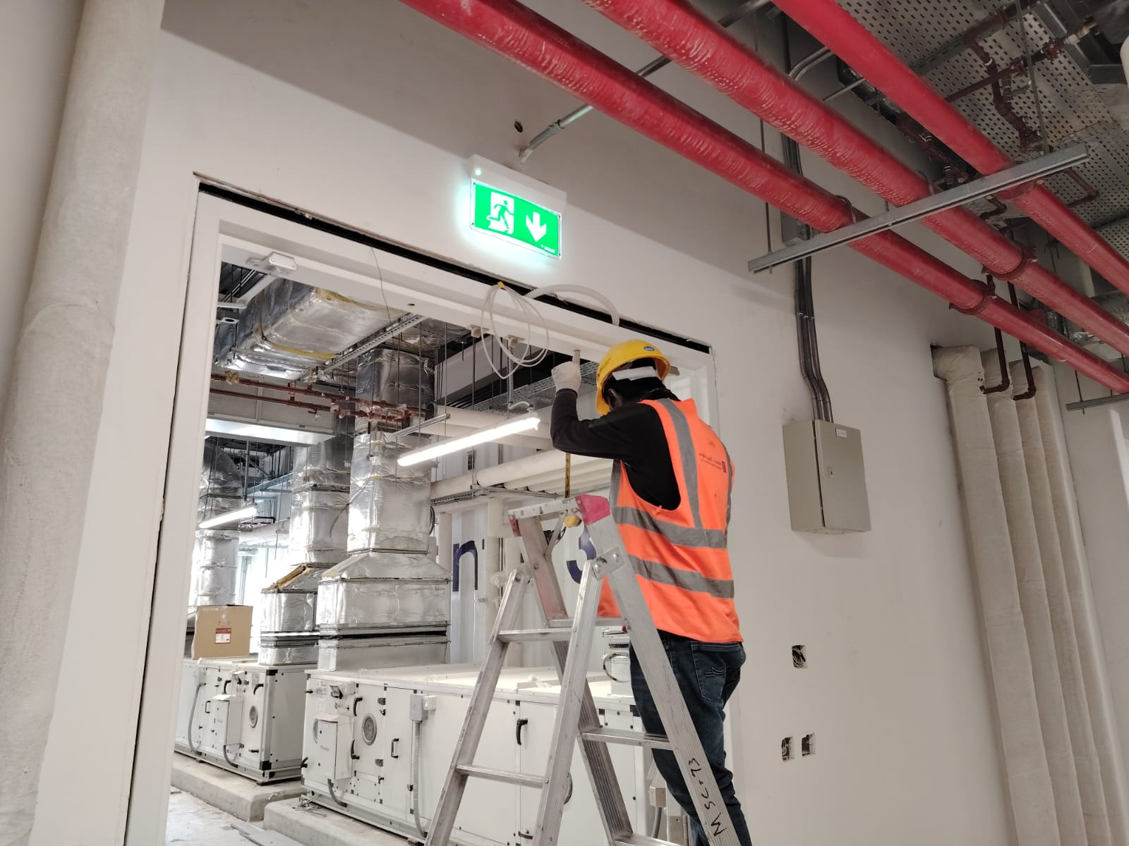
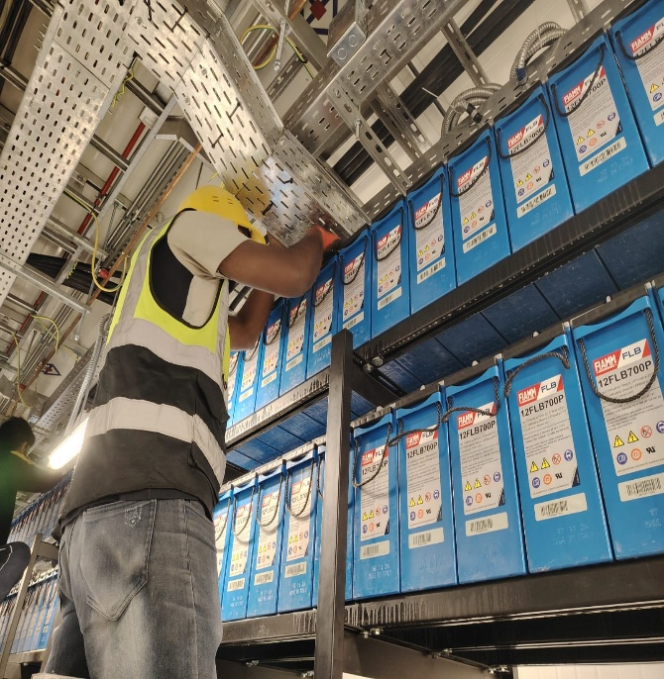
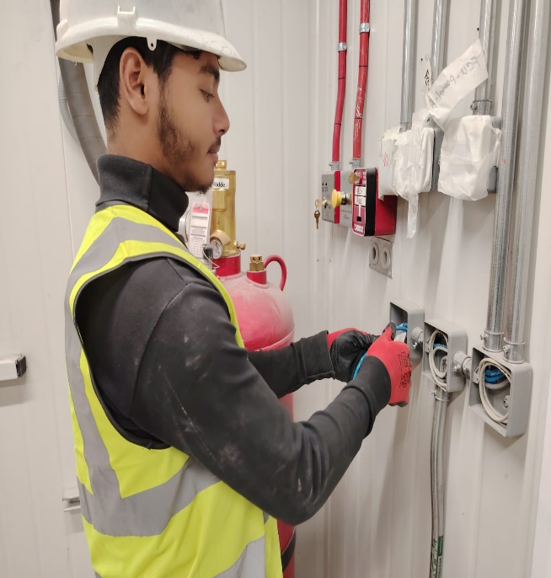
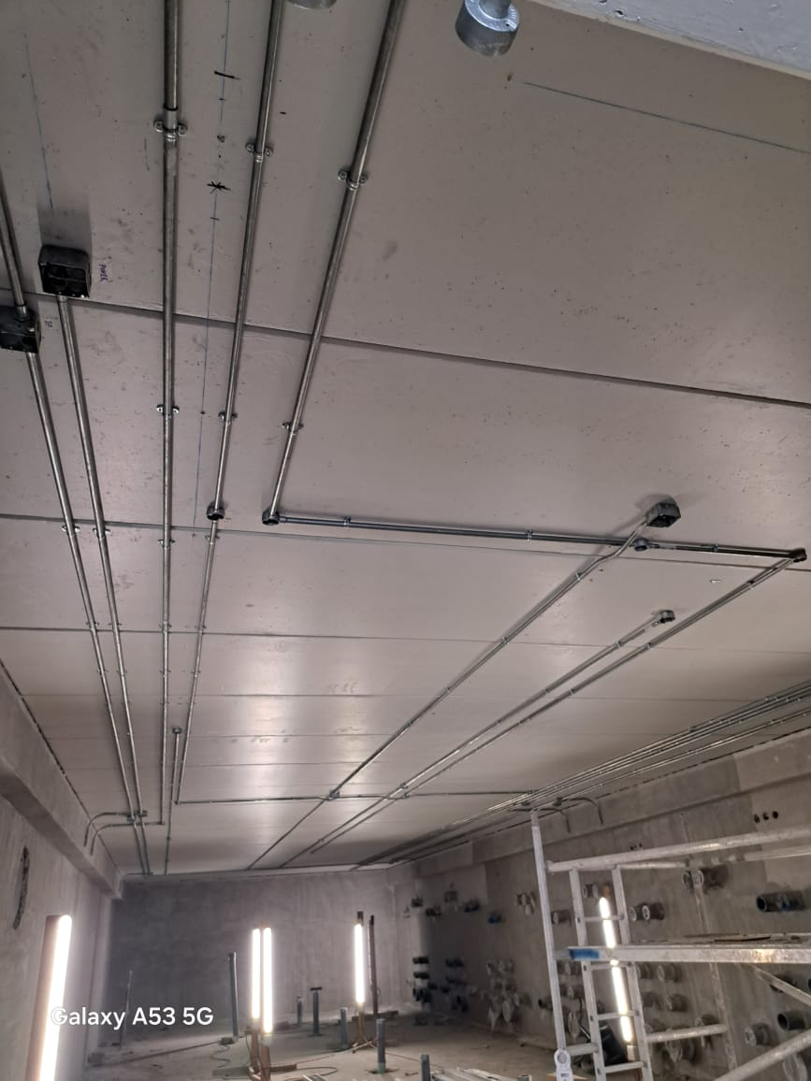
ON GOING PROJECTS
Client:
Main Contractor
Location Project
Project Type
Project Duration
: MENA
: Saudi Development & Export Services Co Ltd
: Dammam
: Sea Port Project
: Hotels and Resorts
: 1 year
Scope of Work:
Scope of Work: Supply, Install, Testing & Commissioning of Mechanical and Electrical Services at MENA Sea Port Project.
Electrical Works: Installation of RMUs and its Termination and Testing and Commissioning.
Installation of Lightning System, Distribution Panels, MCC, Sub-distribution Panel Boards, Cable Trays, Cable Ladder, LV- Cables, LC Cables, External Lighting Fixtures, Internal Lighting Fixtures, Wiring Devices, Disconnect Switches, Fire Alarm System, Telephone & Data System, Public Address System, Access Control System, CCTV System.
Fire Fighting System & Plumbing: Fire Sprinkler system, Fire Pumps, Water Supply System, Drainage System, Strom water System, Sanitary Fixture installation, Diesel Tank Installation and Piping, LPG system HVAC System: Supply and Installation of HVAC system including PACU and Duct work.

Slide 15
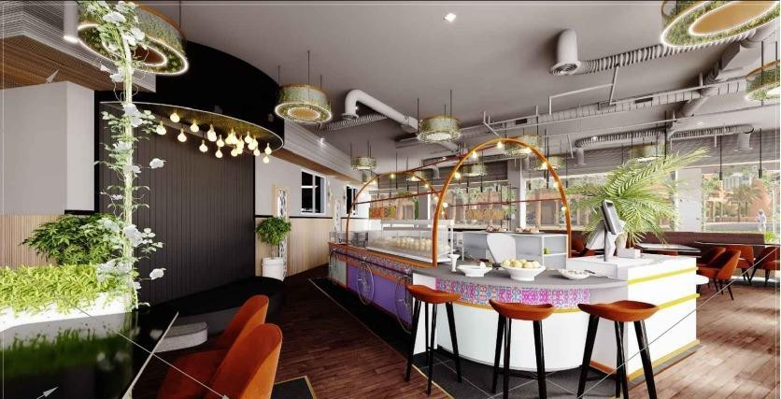
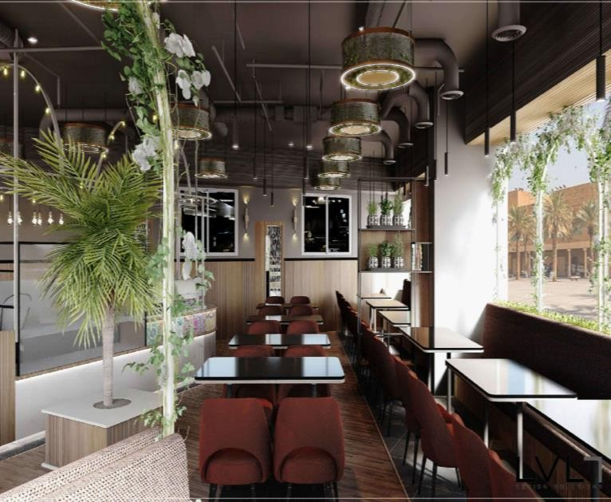
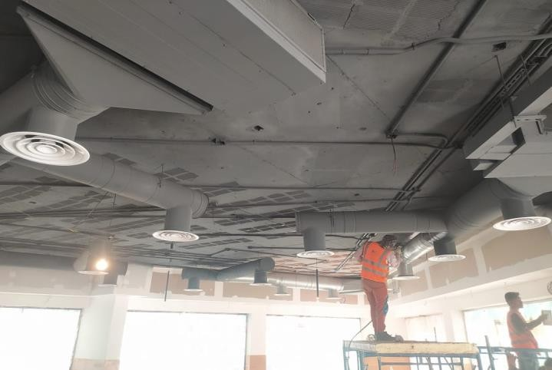
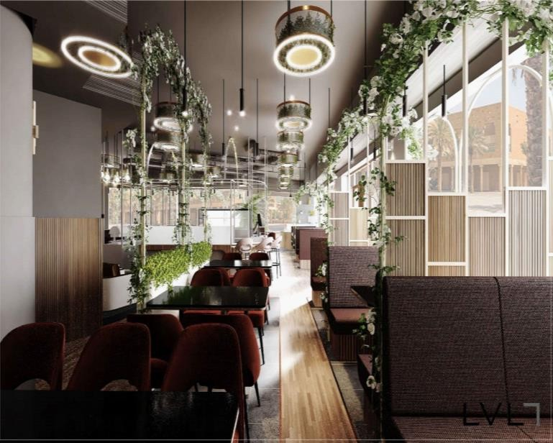
Recently Completed PROJECT
Client:
Main Contractor
Location Project Project Area
Project Duration
: DR.MASOOD
: RENOVIX CONTRACTING COMPANY.
: Riyadh
: KOILA RESTAURANT
: 295 M2
: 5 Months
Scope of Work: Preparation of Shop Drawings with Clients Concern, Supply, Install, Testing & Commissioning.
Civil & Architectural Works: Demolitions, MEP Trench, Metal Works, Stainless Steel Tables, Porcelain & Vinyl Flooring, Gypsum Ceiling, Partitions & Acoustic Ceilings, Painting Works, Mechanical Stone and Tile Fixing.
Electrical Works: Installation of Lightning System, Distribution Panels, MCC, Sub-distribution Panel Boards, Cable Trays, Cable Ladder, LV- Cables, LC Cables, External Lighting Fixtures, Internal Lighting Fixtures, Wiring Devices, Disconnect Switches, Fire Alarm System, Telephone & Data System, Public Address System, Access Control System, CCTV System.
Fire Fighting System & Plumbing: Fire Sprinkler system, Fire Pumps, Water Supply System, Drainage System, Strom water System, Sanitary Fixture installation, Diesel Tank Installation and Piping, LPG system HVAC System: Supply and Installation of HVAC system including PACU and Duct work. Cold Room Construction along with installation of Ev pronator Coil and Condenser Unit installation And its piping Work.

Slide 16
Some of the Previous Project’s
Highlights

Slide 17

DATA CENTER (MEP) MISC
(PRINCE MOHAMMED BIN SALMAN
NOW-PR0FIT CIW), RIYADH
Client: MISC (Prince Mohammed Bin Salman Non-profit City) Main Contractor: Solution By STC
Main Contractor & Our Client: China Saudi Communications Service Ltd Co.
Location: Riyadh, KSA
Scope af Work:
Power System
Cooling System
ELV System
Fire System
Plumbing System
Huawei Equipment
Transformer & MV
(9005 DC PH2), RIYADH
Client: Dawiyat
Main Contractor & Our Client: China Saudi Communications Service Ltd Co.
Scope of Work:
Civil Works
Power System
Cooling System
ELV System
Fire System
Plumbing System
Huawei Equipment
Transformer & MV
www.conceptlnv.com

Slide 18
DAWIYAT DATA CENTER-POWER ROOM
RIYADH
Client: Dawiyat
Main Contractor & Our Client: China Saudi Communications Service Ltd Co.
Scope of Work:
Additional Distribution Transformer Room-2 Power System.
Distribution Transformer Room.
Concrète Tunnel Specification.
Cable duct Specifications.
LV Cable Trench.
LV Power Cables.
1600A SEC Isolation panel.
PHASE 1 ESKAN
Client: SANGCOM
Main Contractor & Our Client: ITEA international Ltd.
Scope of Work:
Optical Fiber Networks
Civil Works
Power System
Cooling System
ELV System
Location: East Region ( Riyadh , AI Hassa , Dammam, Jubial and AI Khubar)
PHASE 2 ESKAN
Client: STC
Main Contractor & Our Client: ITEA INTERNATIONAL COMPANY LTD
Scope of Work:
Fiber To The Home(FTTH)
Installation of Fiber Optic Cable
Splicing of Cable
Testing & commissioning
Location: Madina, Eskan
www.conceptinv.com

Slide 19

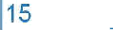
INSTITUTE OF PUBLIC ADMINISTRATION
DAMMAM (IPA)
Client: Quantum ESC0
Scope of Work: Retrofit (implementing energy efficiency measures to reduce a facility's energy consumption)
Location: An Nasriyah, Dammam 32233
PUBLIC SECURITY DEPARTMENT HEAD OFFICE,
RIYADH
Client: Quantum ESC0
Scope of Work: Retrofit (implementing energy efficiency measures to reduce a facility's energy consumption)
Location: MM3P+FVC, Riyadh.
SAUDI ELECTRICITY COMPANY (SEC), RIYADH
Client: ITEA International Ltd.
Scope of Work: Unified Contract Distribution Network up to 36 KVA MV, HV Construc- tion, Maintenance & Civil Works
Location: Riyadh City.
DELTA CJSC, RIYADH
Client: Delta Closed Joint Stock Company.
Project Name: Saudi Electricity Company (SEC) Unified Contract Distri- bution Network up to 36 KVA MV, HV Construction, Maintenance & Civil Works
Location: Riyadh City
www.conceptinv.com

Slide 20
RECENTLY COMPLETED PROJECT
Client:
Main Contractor
CONSULTANT
Location Project
Project uration PROJECT COST
: STC
: ACES
: STC
: DUBA
: STC-DUBA REHAB PROJECT
: 3 MONTHS
: 0.7 MILLION
Scope of Work: mep & civil work.
Scope: civil works mechanical work-HVAC. Electrical works-low voltage &low current.
Client:
Main Contractor
CONSULTANT
Location Project
Project Duration
PROJECT COST
: DARUL RIYADH
: SEDIARY ABDUL RAHMAN CONTRACTING.CO
: DARUL RIYADH
: RIYADH
: DARUL-RIYADH HQ BUILDING
: 3 MONTHS
: 205 MILLION
Scope of Work: mep work.
Renovation of all mep service for 8 floor building.

Slide 21
RECENTLY COMPLETED PROJECT
Client:
Main Contractor
CONSULTANT
Location Project
Project Duration PROJECT COST
: KAFD
: MARCO
: JLL
: RIYADH
: KAFD PROJECT (304)
: 2 Months
: : 0.5 MILLION
Scope of Work: Installation of electrical work.
Scope includes, low voltage,low current system.
Client:
Main Contractor
CONSULTANT
Location Project
Project Duration PROJECT COST
: SDRS
: SAUD AL GHANDI CONTRACTING.CO
: NERMA&PARTNERS.
: DAMMAM
: SDRS EXPORTS-DAMMAM SEAPONT.
: 1 MONTHS
: 1.2 MILLION
Scope of Work: electrical substation works.
Supply and installation of electrical substation 1500kva, along with panel installation and all related civil works.

Slide 22
RECENTLY COMPLETED PROJECT
Client:
Main Contractor
CONSULTANT
Location Project
Project Duration PROJECT COST
: ROYAL COMISSION RAS AL KHAIR
: NESMA ARABIA COMPANY
: ROYAL COMMISION RAS AL KHAIR
: RAS-AL KHAIR
: RAS AL KHAIR(MEDICAL CLINIC)
: 2 Months
: 0.2 MILLION
Scope of Work: Installation of fire fighting system for the medical clinics.
Fire fighting network installation.
Client:
Main Contractor
CONSULTANT
Location Project
Project Duration
PROJECT COST :
: NEODON
: MARCO
; JASARA
: SUDAIR
: RBF PROJECT
: 8 Months
1.6 MILLION
Scope of Work: Installation of electrical work and mechanical work.
Scoped includes, low voltage low current system mechanical work, fire fighting plumbing works.

Slide 23
RECENTLY COMPLETED PROJECT
Client:
Main Contractor
CONSULTANT
Location Project
Project Duration PROJECT COST
: SAUDI CUSTOM OFFICE
: CFB
: AECOM
: RIYADH
: SAUDI CUSTOM OFFICE
: 6 Months
: 0.5 MILLION
Scope of Work: MEP
Scope includes low voltage, low current, fire fighting urv,drainage system.
Client:
Main Contractor
CONSULTANT
Location
Project
Project Duration
: LINA MARK
: IBRAHIM SAEED CONTRACTING
: IMPACT CONSULTANT
: RIYADH
: LINA MARK ACCOMADATION BUILDING
: 1 YEAR
PROJECT COST : 2 MILLION
Scope of Work: Hvac work
Hvac duet work & dx system installation & copper pipe.

Slide 24
RECENTLY COMPLETED PROJECT
Client:
Main Contractor
CONSULTANT
Location Project
Project Duration PROJECT COST
: PRIME MAJEED
: SEDIARY ABDUL RAHMAN CONTRACTING.CO
: DARUL RIYADH
: RIYADH
: PMV- VILLA PROJECT
: 2 MONTHS
: 0.2 MILLION
Scope of Work: Electrical substation works.
Termination of all electrical, panel as per sld.
Client:
Main Contractor
CONSULTANT
Location Project
Project Duration PROJECT COST
: ALMARAI
: EUROCHINA
: ALMARAI
: AL-KHARJ
: ALMARAI PROJECT-AHU REPLACEMENT
: 3 DAYS
: 0.15 MILLION
Scope of Work: ahu replacement.
Installation of ahu’s along with its platform extension works.

Slide 25
RECENTLY COMPLETED PROJECT
Client:
Main Contractor
CONSULTANT
Location Project
Project Duration PROJECT COST
: MOH
: SHAKA GROUP-ESCO
: TARSHID
: RIYADH
: KING SALMAN HOSPITAL PROJECT
: 2 MONTHS
: 0.35 MILLION
Scope of Work: replacement pacu & dx units.
Replacement of all pacu units for diabetic & opd installation of dx unit.
Client:
Main Contractor
CONSULTANT
Location Project
Project Duration
PROJECT COST
: IFTAH
: SHAKA GROUP-ESCO
: TARSHID
: RIYADH
: IKTAH-RIYADH
: 1 MONTHS
: 0.15 MILLION
Scope of Work: replacement of light.
Replacement of light fixtures as per tarshid requirement.

Slide 26
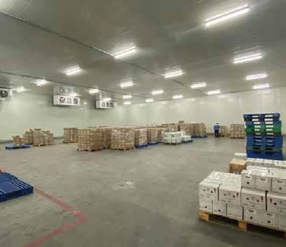
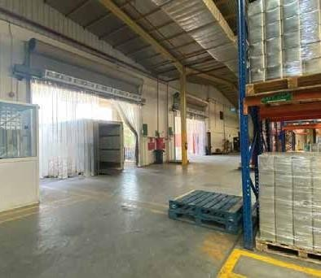
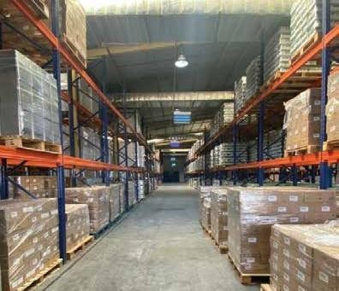
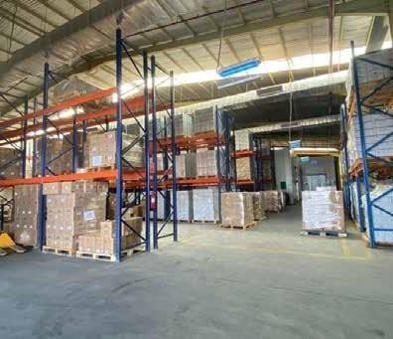
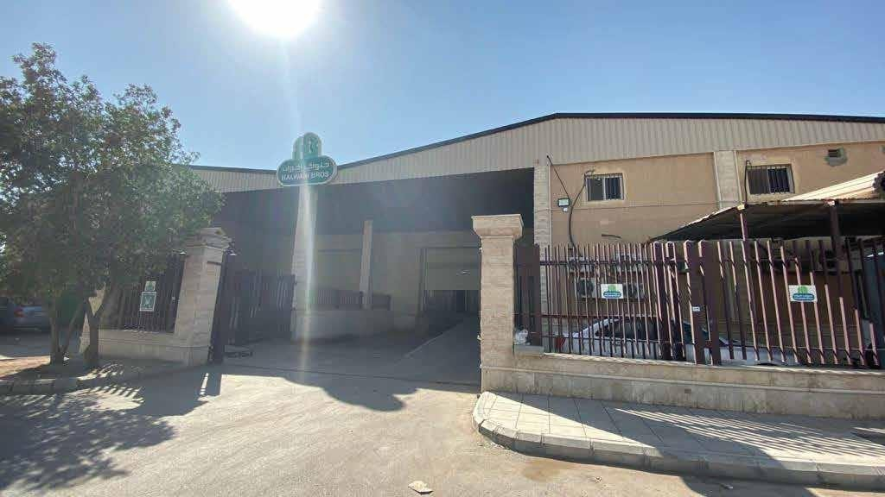
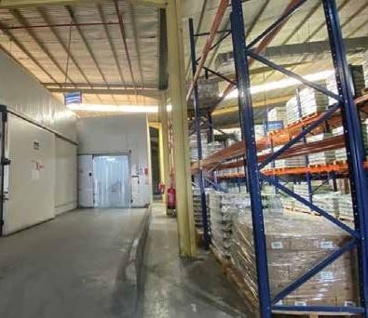
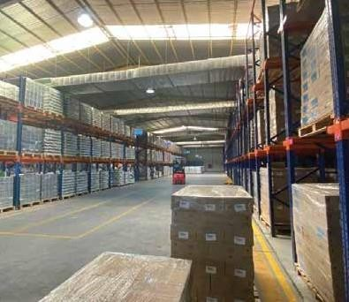
PROJECTS
Client
Main Contractor
Location Project Project Area
Project Duration
: Halwani Bros
: RENOVIX CONTRACTING COMPANY
: Sulehi, Riyadh
: Warehouse
: 4,500m2
: 4 Months
Scope of Work:
Supply and Installation of Electrical System along with
Testing & Commissioning
Electrical Works:
Lightning System, Emergency Light, Main-distribution Panel
Boards, Cable Trays, LV Cables, External Lighting Fixtures, Wiring Devices, Disconnect Switches, Earthing System.

Slide 27
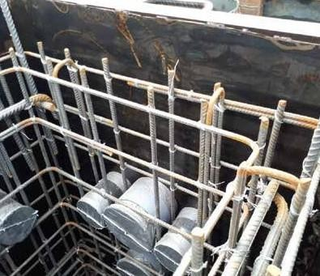
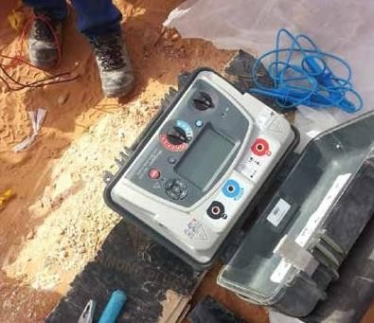
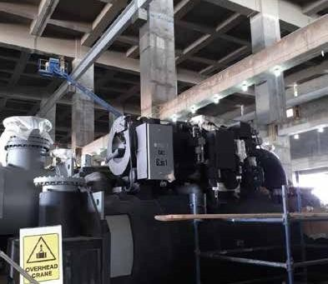
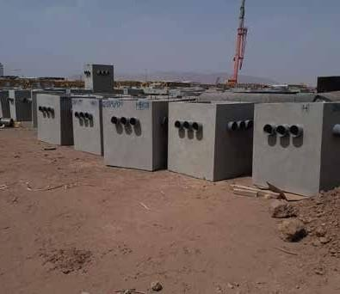
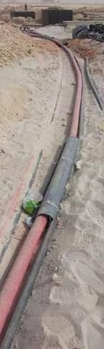
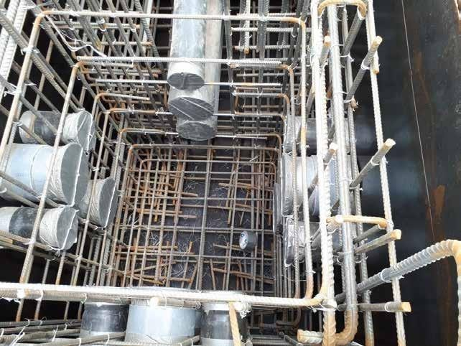
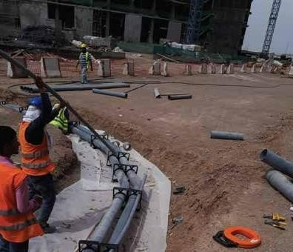
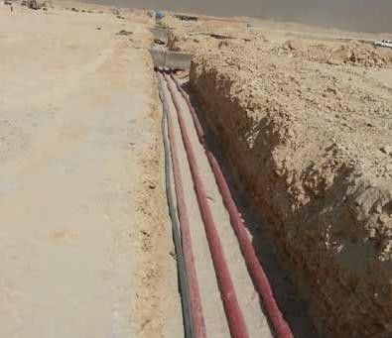
PROJECTS
Client
Main Contractor
Subcontractor Location Project Project Area
Project Duration
: Ministry of Finance
: Al Fouzan General Construction Co
: ERAS Technology
: Riyadh
: GAC
: 280,000m2
: 18 Months
Scope of Work:
Electrical Infrastructure Work
Electrical Works: Laying of MV Cables

Slide 28
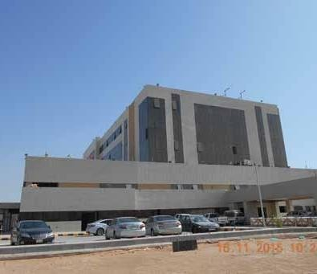
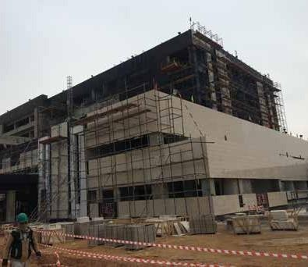
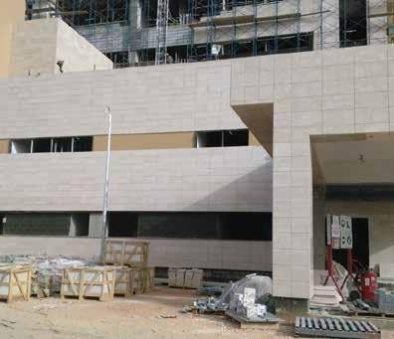




PROJECTS
Client
Main Contractor
Location Project Project Area
Project Duration
: Ministry of Health
: Khatib Al Alami
: Exit 21, Riyadh
: Al Iman Hospital - Extension
: 380,000m2
: 18 Months
Scope of Work:
Execution, Install.
Civil & Architectural Works:
Concreting, CHB Works, Plastering, Screed Works, Metal
Works, Joinery Works, Gypsum Partitions, Gypsum & Acoustical Ceiling, Painting Works, Marble and Porcelain Tile Fixing.

Slide 29






PROJECTS
Client
Main Contractor
Location Project Project Area
Project Duration
: Halwani Bros.
: Al Fanayah Contracting
: Jeddah
: Water Tank
: 4,250m2
: 2 Months
Scope of Work:
Supply & Fabrication of Water Tank
Metal Fabrications & Mechanical Works:
Tank Fabrication along with all Mechanical Works

Slide 30























OUR MAJOR CLIENTS

Slide 31
2091, Makkah Al Mukarramah Branch Road,
Al Sulaymaniyah District,
Riyadh, KSA.
info@renovixcosntruction.com
www.renovixconstruction.com

